Slide 1

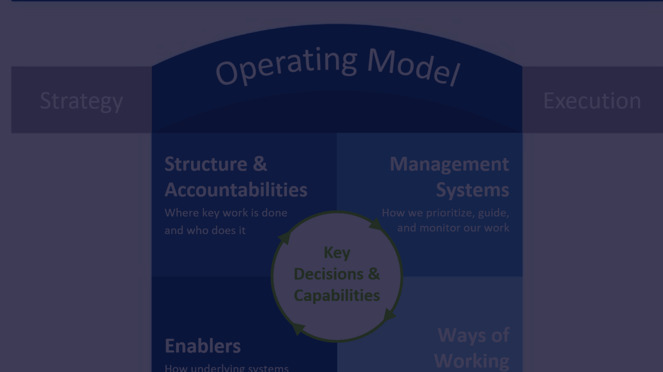

By – MAHESH SHENDRE
Case Study: Optimizing Data Operations Team Efficiency
Professionally there are some steps, procedures and protocols needs be follow for the detailed and complete Case study on the Business intelligence. And some of them are as follows.

Slide 2

Introduction
A newly appointed Team Leader in the Data Operations Team at PitchBook requires insights to enhance the team's productivity and streamline processes. The team, responsible for secondary research on private companies, encounters various workflows in their daily tasks. The case study aims to utilize business intelligence tools to analyze and interpret sample data, providing actionable insights to the Team Leader.
Provide background information about the company or organization.
Highlight the industry and competitive landscape detail.

Slide 3
Business Challenges
The time taken for workflow completion is measured in seconds, and the added data is quantified as benchmark points. Workflows are categorized by information tracked, process types, and the regions from which data is gathered. The team encounters challenges when workflows are created with incorrect details or on the wrong profile, leading to an "unassigned" status, subsequently completed by a more relevant team.
Discuss the impact of these challenges on the overall business operations.

Slide 4
Objectives and Goals
Clearly state the objectives the company aimed to achieve with BI implementation. Define the goals and key performance indicators (KPIs) used to measure success.
Highlight the industry and competitive landscape.

Slide 5
BI Tools and Technologies
Detail the BI tools and technologies chosen for implementation. Explain the reasons behind selecting these tools and how they align with business needs.
Discuss the process of integrating data from various sources into the BI system.

Slide 6
Data Sources and Integration
Describe the sources of data used for BI analysis. Discuss the process of integrating data from various sources into the BI system.
Private Equity (PE)
Venture Capital (VC)
Mergers & Acquisitions (M&A)
Fundraising
Industry Group Changes
Company data Workflow

Slide 7
Implementation Process
Outline the steps taken to implement the BI solution. Discuss any challenges faced during the implementation and how they were overcome.
Explain the reasons behind selecting these tools and how they align with business needs.

Slide 8

Benefits and Outcomes
Present the positive outcomes achieved through BI implementation. Quantify improvements in key areas such as efficiency, decision-making, and profitability.
Discuss any challenges faced during the implementation and how they were overcome.

Slide 9
Case Study Results
Showcase specific examples or use cases where BI played a crucial role. Provide before-and-after scenarios to illustrate the impact.
Discuss lessons learned from the BI implementation process.

Slide 10

Lessons Learned
Discuss lessons learned from the BI implementation process. Highlight any adjustments or improvements made post-implementation.
Summarize the key points discussed in the case study. Reinforce the overall success of the BI implementation.

Slide 11
Future Plans and
recommendations
Share the company’s plans for future BI Enhancement.
Provide recommendations based on the experience and outcomes.

Slide 12
Conclusion
Summaries the key points discussed in the case study
Reinforce the overall success of the BI Implementations.

